Slide 1
Flight Price Prediction Project
Submitted by – Amruta Shah

Slide 2
Problem Statement: -
Anyone who has booked a flight ticket knows how unexpectedly the prices vary. The cheapest available ticket on a given flight gets more and less expensive over time.
This usually happens as an attempt to maximize revenue based on -
1. Time of purchase patterns (making sure last-minute purchases are expensive)
2. Keeping the flight as full as they want it (raising prices on a flight which is filling up in order to reduce sales and hold back inventory for those expensive last-minute expensive purchases)
So, you have to work on a project where you collect data of flight fares with other features and work to make a model to predict fares of flights.

Slide 3
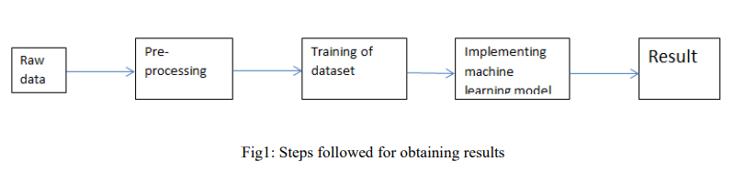
Methodology:-
The steps followed in this work, right from the dataset preparation to obtaining results are represented in Fig.

Slide 4
EDA (Exploratory Data Analysis):-
Import libraries: -
Import pandas as pd # for data manipulation
Import numpy as np # for mathematical calculations
Import seaborn as sns # for data visualization
Import matplotlib.pyplot as plt #for graphical analysis
%matplotlib inline
Import warnings # to ignore any warnings

Slide 5
Technical Requirements:
Mathematical Summary:
Dimensions of Dataset: There are 10 columns and 1718 rows in this dataset.
Duplicates: The duplicates are found in dataset which I have deleted.
Null Values: There are null values present in dataset which is teared well by using NumPy and pandas’ techniques.
Statistical Summary:
Skewness: Skewness is present in columns.
Outliers are present in the target variable.
Data Sources and their formats
Data Sources: We have dataset with 1718 rows × 10 columns. We have taken from different websites like yatra, sasta safer , makemy trip etc. The data was converted into a Pandas Data frame under various Features and Label columns and saved as a .csv file.
Data Formats: Flight Name, Total stop, departure place and arrival place are object datatype which we need to encode & many other columns which we need to pre-process.

Slide 6
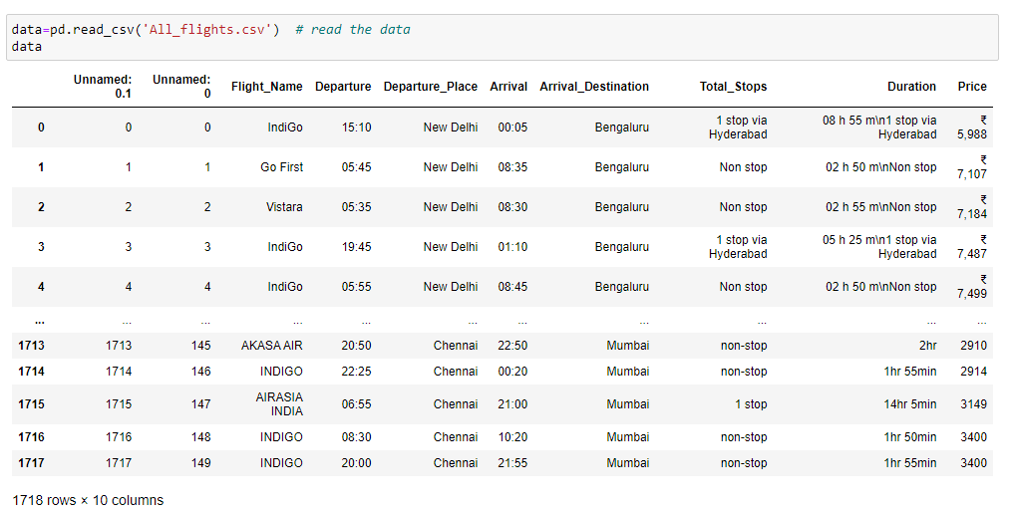
Load Dataset

Slide 7
Observations
Dimensions of Dataset: There are 15 columns and 1718 rows in this dataset.
Null Values: There are null values are present in this dataset.
Outliers: Outliers are present in the target variable.
Skewness: Skewness is present in the dataset.

Slide 8
Data Visualization
We now have a basic idea about the data. We need to extend that with some visualizations. We are going to look at three types of plots:
Univariate plots to better understand each variable.
Bivariate plots to find relationship between two variables,
Multivariate plots to better understand the relationships between variables.

Slide 9
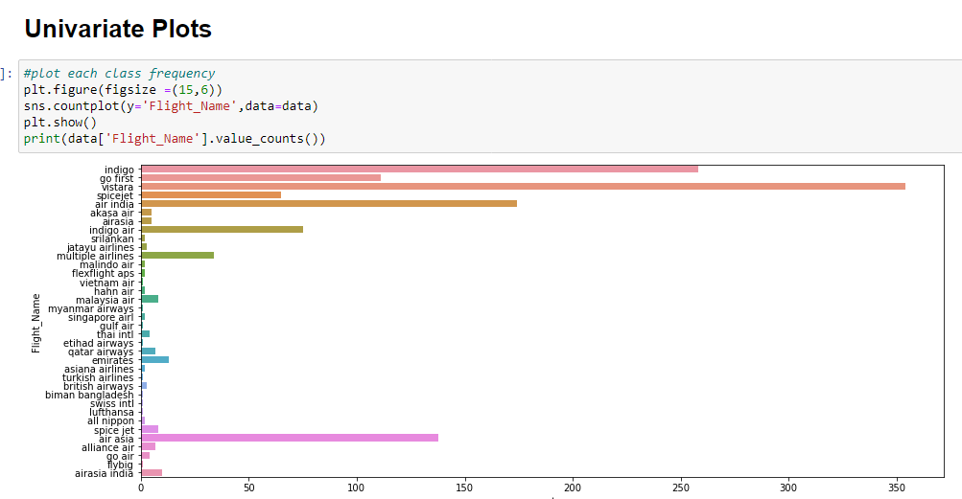
Univariate Plots:-

Slide 10
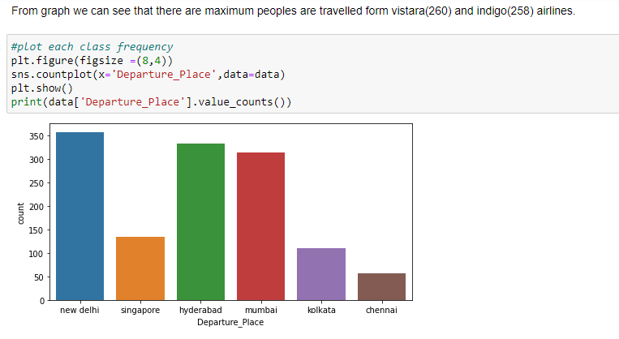

Slide 11
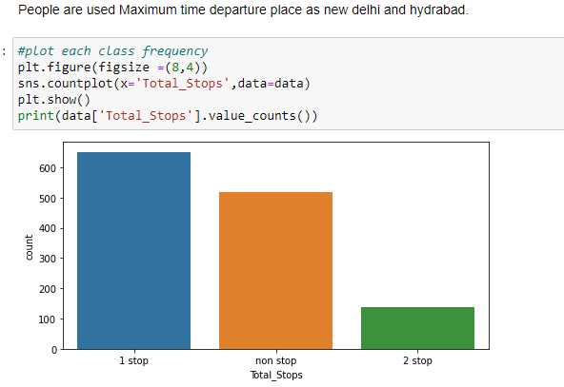

Slide 12
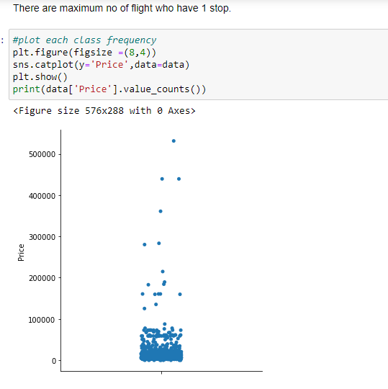

Slide 13
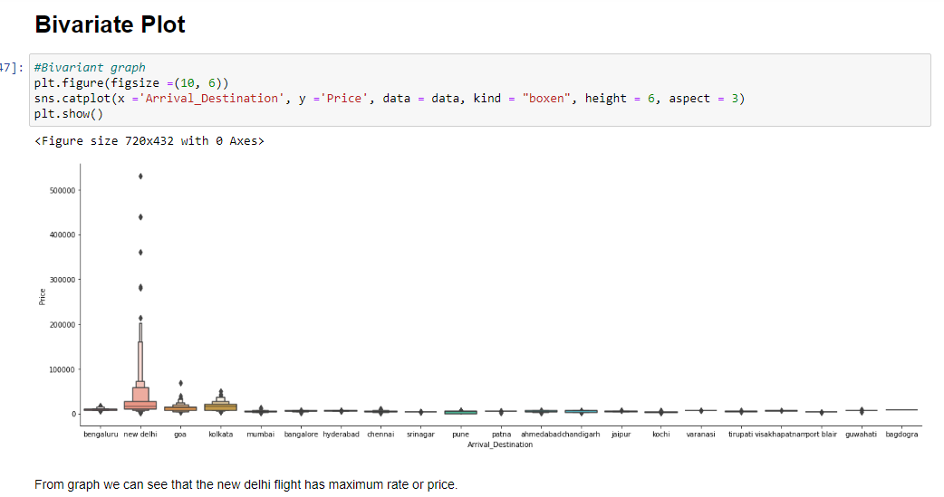

Slide 14
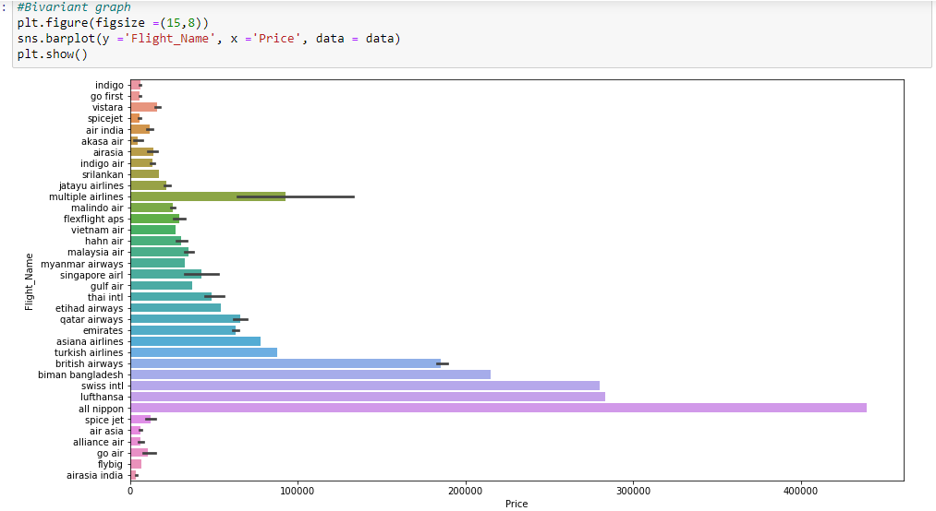

Slide 15
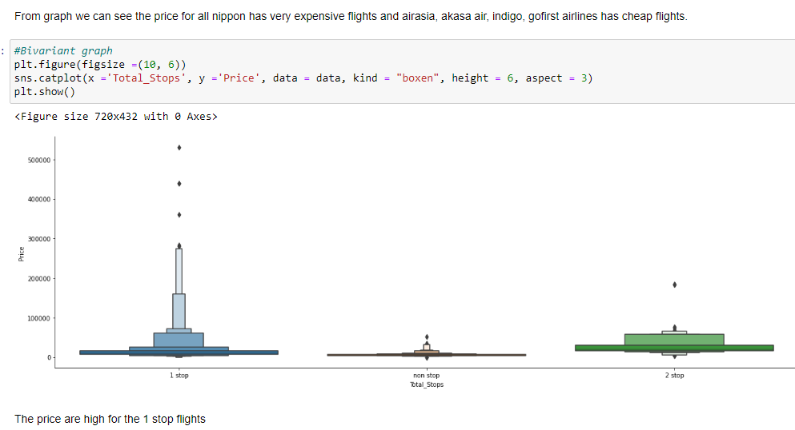

Slide 16
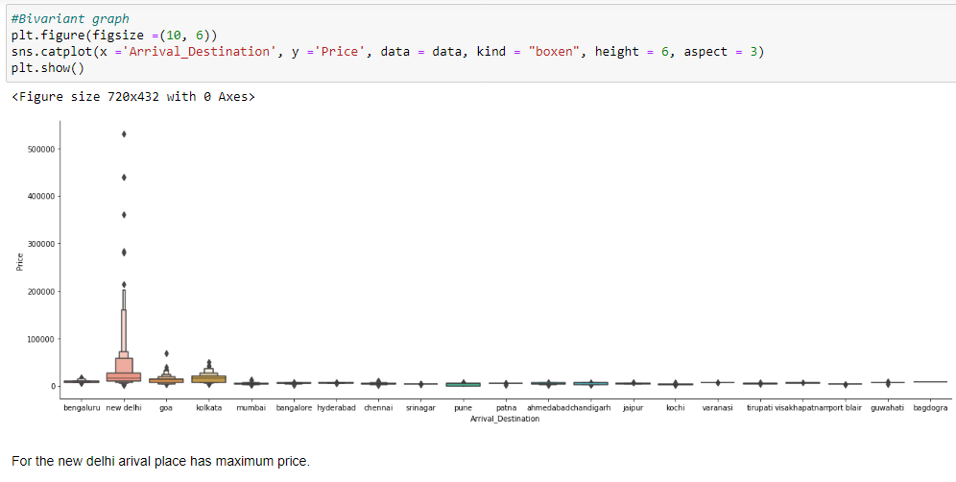

Slide 17
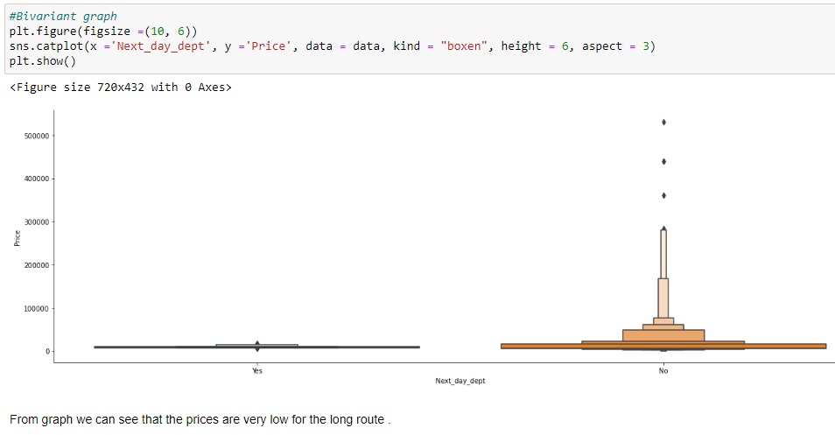

Slide 18
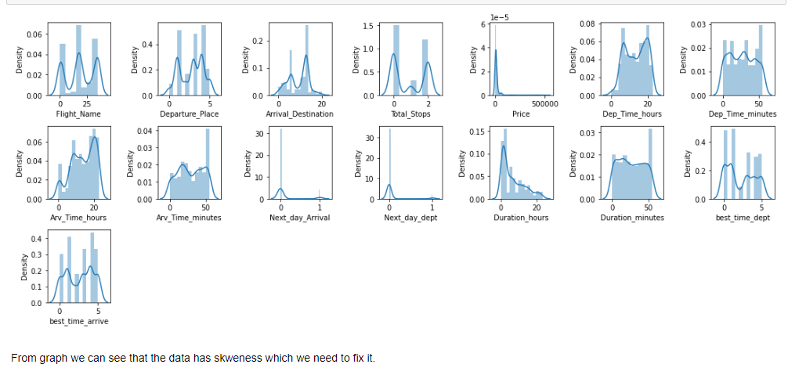
Multivariate Plot

Slide 19
Data Pre-processing:-
First of all, I have deleted unnecessary columns like unnamed 0 and then I have checked for the duplicates & treated well. Then check for the statical summary to check skewness, null values& outliers and noted the observations. Moving further I have convert all the data into lower case by using string.lower() method. Further, I have done some data pre-processing techniques and methods and create new necessary columns by using existing columns for data analysis. Used some encoding tech to convert the data form object type to int for further process.
All steps are shown below.

Slide 20
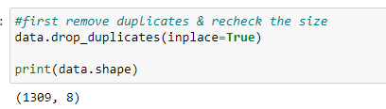

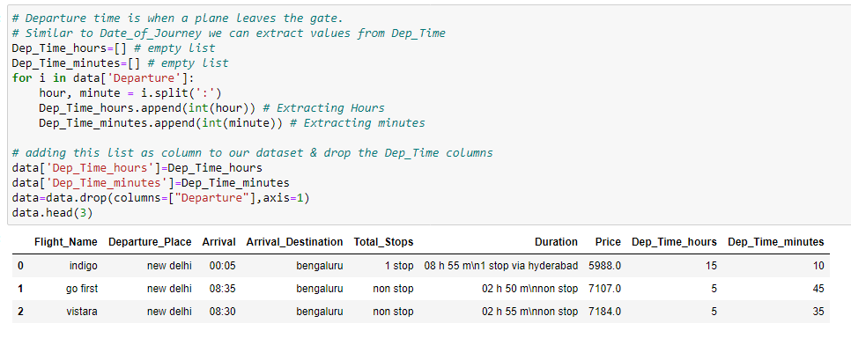
Data Pre-processing:-

Slide 21
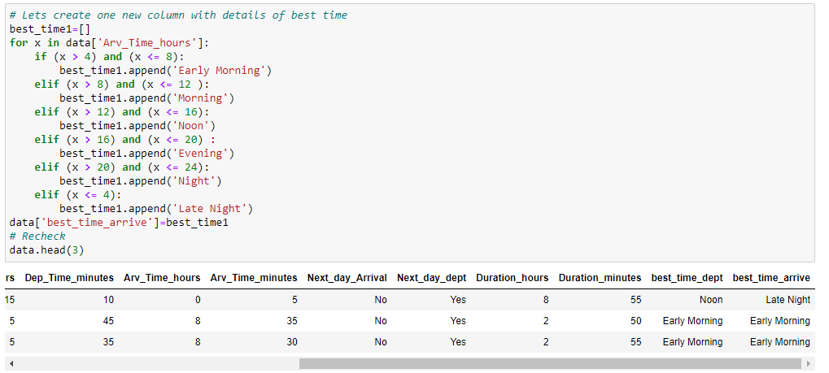
Data Pre-processing:-

Slide 22
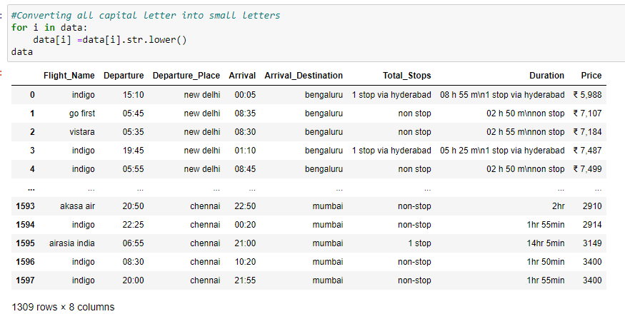
Data Pre-processing:-

Slide 23
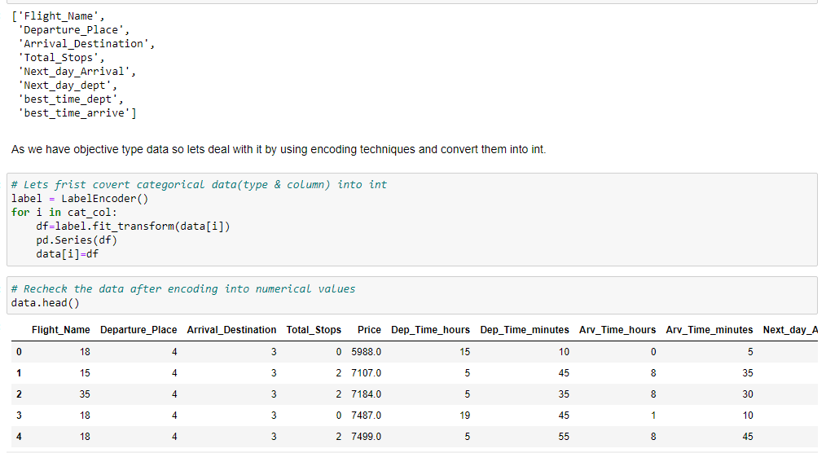
Data Pre-processing:-
As our dataset has objective type data so covert them into int by using Encoding method as shown.

Slide 24
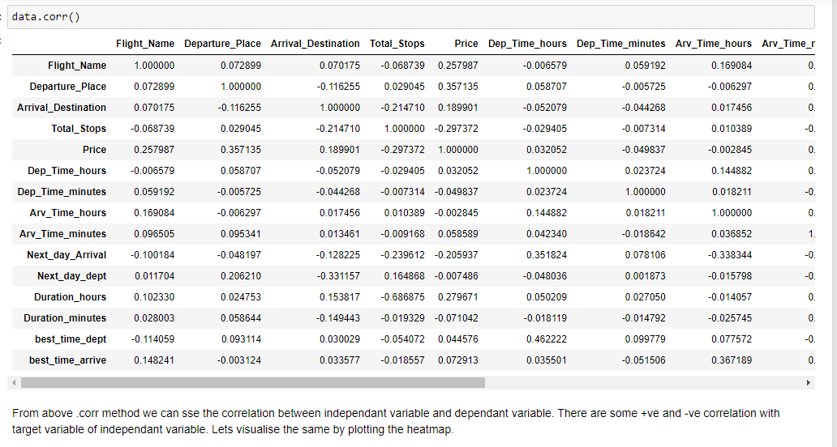
Data Inputs- Logic- Output Relationships
To check the Input output relation, I have plotted the heatmap and data.corr () technique to check the multicollinearity. As shown in below screenshot. And detected no multicollinearity.

Slide 25
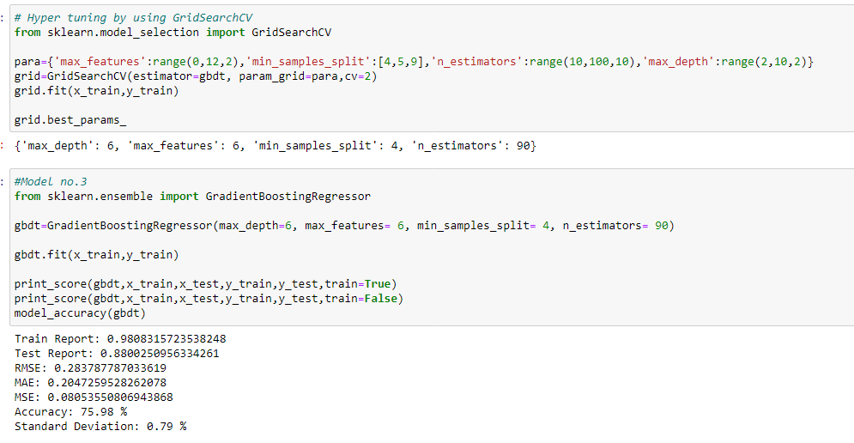
Build the models & select best one

Slide 26
The key findings, inferences, observations from the whole problem are that I found out how to handle the dataset which is null values & there are data need to be pre-process and use for metrics like r2_ score. I observed that data with max 0.357135 correlation with target variable. •Limitations of this work and Scope for Future Work Yes, there is still room for improvement, like doing a more Web scraping from different websites, extensive feature engineering, by comparing and plotting the features against each other and identifying and removing the noisy features. The values of R-squared obtained from the algorithm give the accuracy of the model. In the future, if more data could be scraped such as the business class, so predicted results will be more accurate.
Conclusion and Future Scope: -

